Slide 1
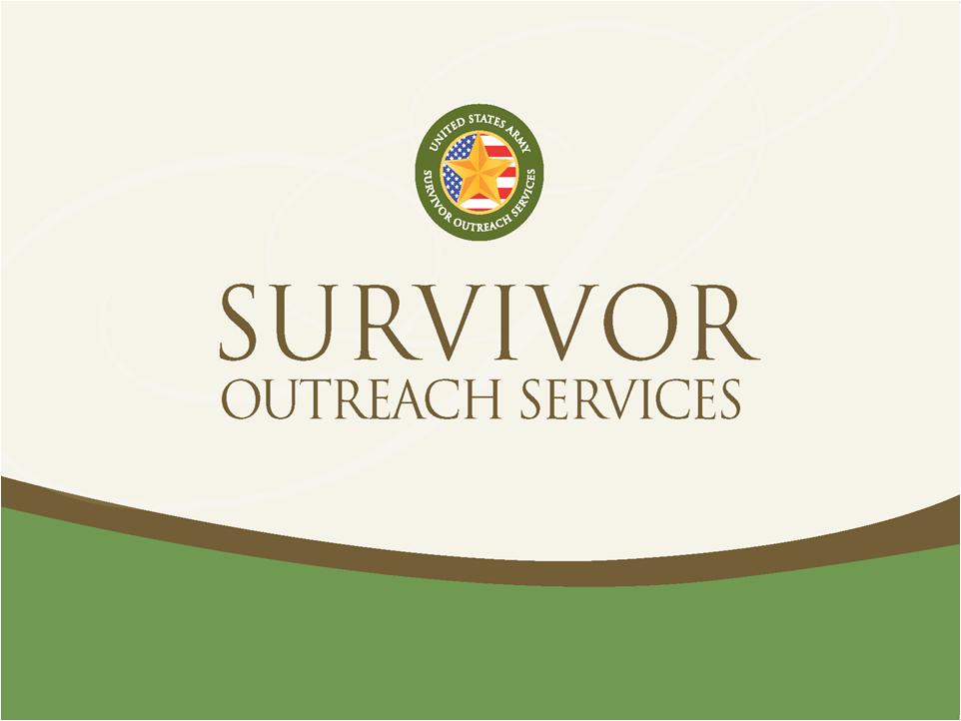
David Dodson
Survivor Outreach Service Coordinator
605-737-6090
david.e.dodson18.ctr@army.mil

Slide 2
SURVIVOR OUTREACH SERVICES
Family Members Most Common Questions:
How can I get military funeral honors/burial benefits?
I have all this paperwork, what do I do with it?
My spouse said there were benefits for me after they died, what are they, how do I get them?
Advocate and Liaison for surviving Families, providing long-term support for as long as they desire
Information and Referral - Assisting surviving Families in accessing benefits and entitlements and meeting needs of surviving Family members
Connecting/Linking - Survivors to local community resources, supportive counseling (grief counseling, financial counseling, Family/group counseling) and support groups

Slide 3
SURVIVOR BENEFITS
Service Benefits
Serviceman’s Group Life Insurance (SGLI)
Survivor Benefit Plan (SBP)
Death Gratuity
Military Funeral Honors
VA Benefits
VA Education Benefits (DEA/Fry Scholarship)
VA Dependent Indemnity Compensation (DIC)
Referrals
Bereavement Counseling
Financial Counseling
Individual/Family Counseling
Legal Counsel

Slide 4
WHO DO WE SERVE?
Surviving Family Members of Fallen Soldiers
Spouse
Parents
Children
Siblings
Grandparents
Fiancée
Others

Slide 5
David Dodson
Survivor Outreach Service Coordinator
605-737-6090
david.e.dodson18.ctr@army.mil

